Slide 1
Week 5 Presentation: Database management with mySQl

Slide 2
MySQL is an open-source relational database management system (RDBMS) that uses Structured Query Language (SQL) for accessing and managing data.
phpMyAdmin: phpMyAdmin is a popular web-based application used for managing MySQL and MariaDB databases.

Slide 3
XAMPP: XAMPP is a free and open-source cross-platform web server solution stack package developed by Apache Friends, consisting primarily of the Apache HTTP Server, MariaDB (formerly MySQL), and interpreters for scripts written in the PHP and Perl programming languages.

Slide 4




XAMPP: The Local Development Environment
Apache
MariaDB/MySQL
Widely used web server software.
Relational database management system.
PHP
Pre-configured Settings
Popular scripting language for web development.
Simplify development setup without manual configuration.

Slide 5
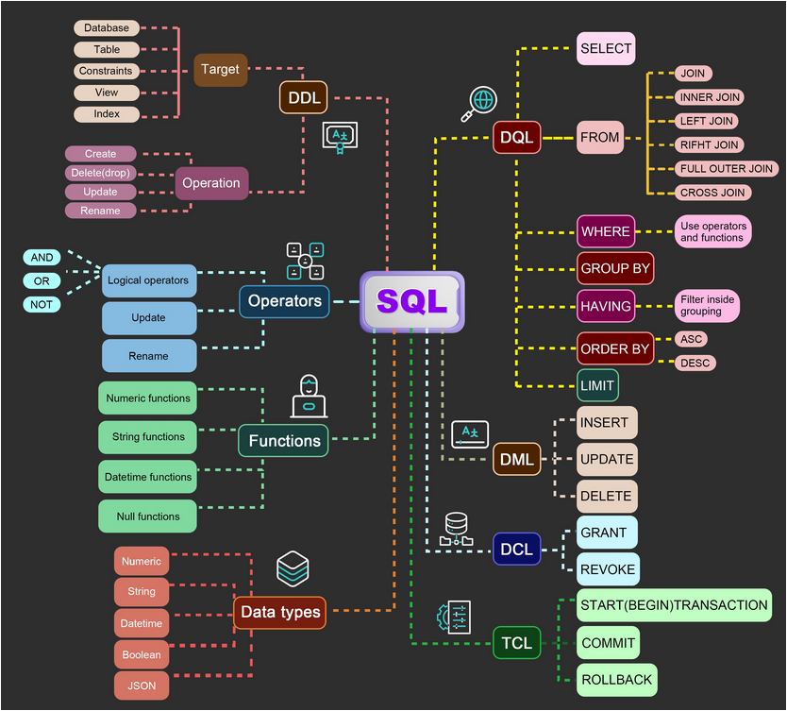
SQL Queries.
There are several types of SQL queries, including:
Data Definition Language (DDL):
DDL statements are used to define and modify the structure of a database.
Data Manipulation Language (DML):
DML statements are used to manipulate the data in a database.

Slide 6
SQL: The Language of Databases
Data Definition Language (DDL)
Data Manipulation Language (DML)
CREATE TABLE
INSERT
CREATE INDEX
UPDATE
CREATE VIEW
DELETE
ALTER TABLE
SELECT
DROP TABLE
Data Control Language (DCL)
GRANT
REVOKE

Slide 7
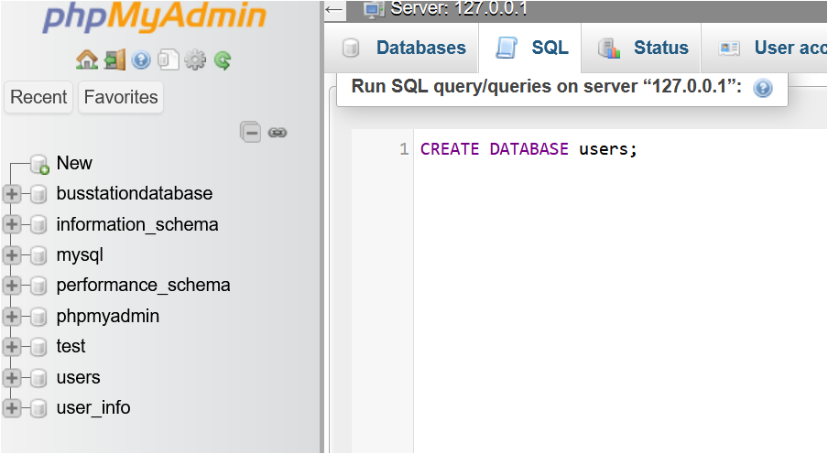
Building a Database: A Practical Example
1
Create a Database
Use phpMyAdmin to create a database for your application.

Slide 8
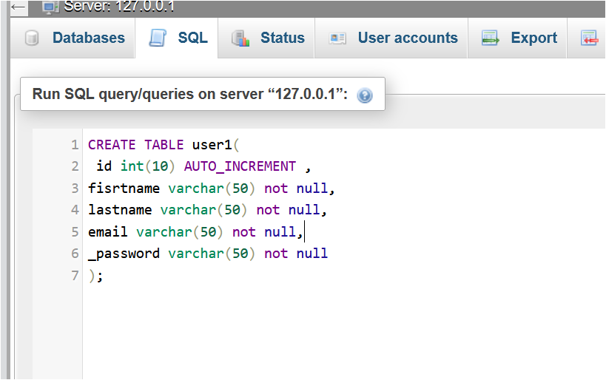
2
Create Tables
Define tables to store user information during signup.

Slide 9
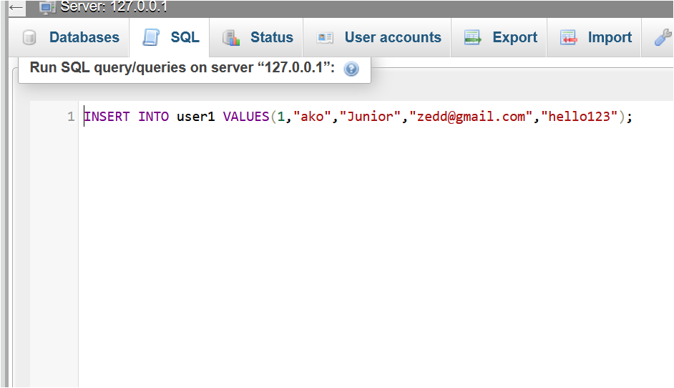
3
Insert Data
Populate the tables with relevant information.

Slide 10
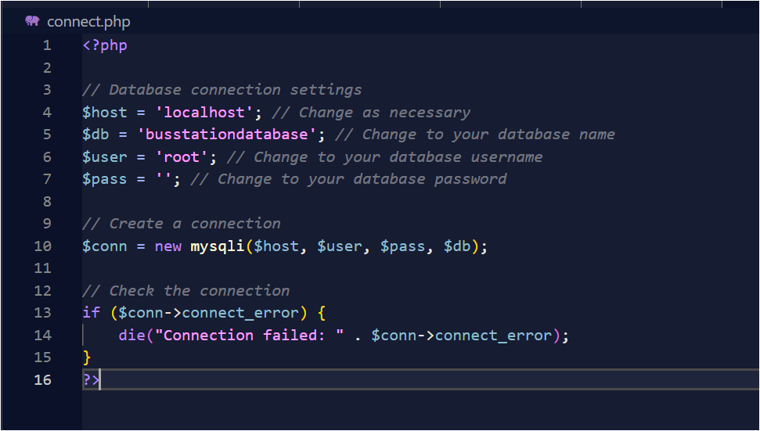
Connecting database to web application

Slide 11
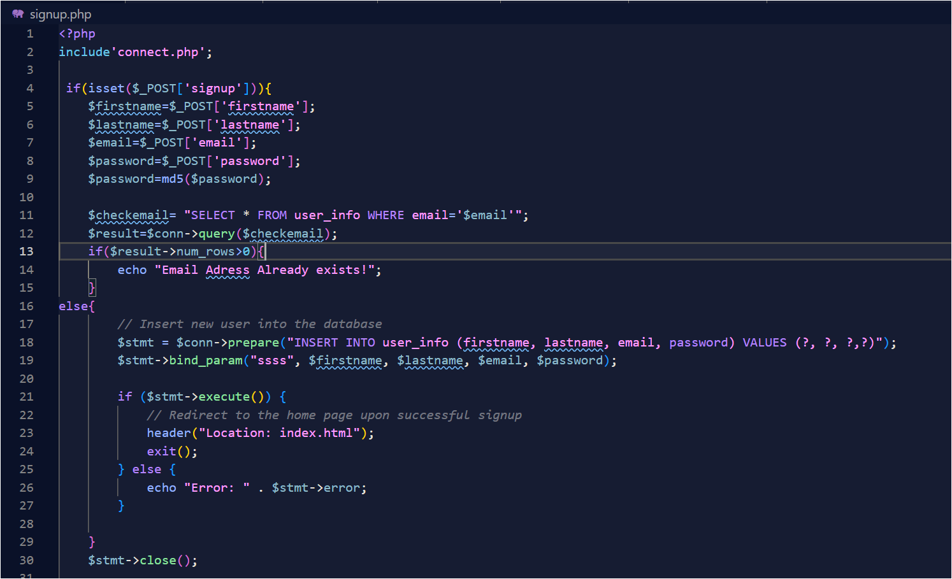
SQL queries implemented for data manipulation (CRUD operations) of signup page.

Slide 12
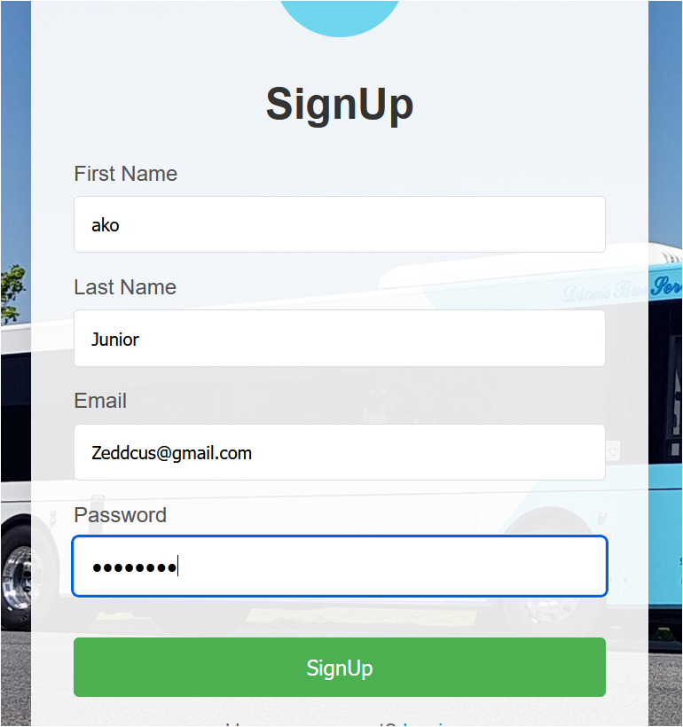
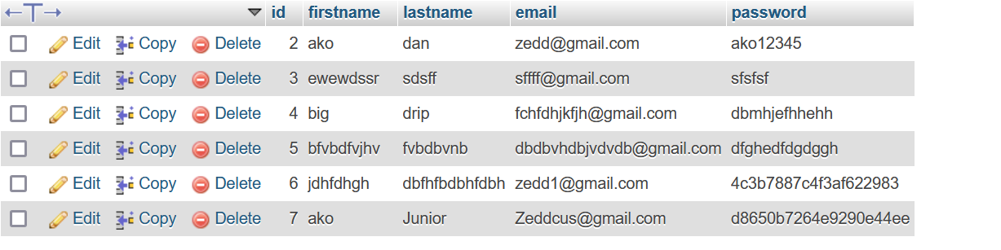
DEMO

Slide 13
THANK YOU

